Slide 1
Creando un Lector
Raising A Reader
Notes:
This is the template for the Cover Option 1 with Photo
-- Click icon to add picture. Crop picture to fit within the white area. (Do not cover grey bar or red bar with photo.)
-- To enter Title and Subtitle, type over the text boxes.
-- Title should be no more than 32pt.
-- Subtitle should be no more than 30pt.
SEE NEXT PAGE FOR SAMPLE OF WHAT THIS COVER OPTION SHOULD LOOK LIKE WHEN PHOTO IS ADDED.

Slide 2
Bienvenidos al programa Creando Un Lector Cada semana se llevan una bolsa roja con libros lindos para leer con sus hijos!
Welcome to
Raising A Reader
Each week you take home a red bag with beautiful books to read with your children!

Slide 3
Objetivos: Objectives:
Enteder la importancia que tiene el compartir libros con su hijos
Understand the importance of sharing books with your children
Establecer una rutina para compartir libros en familia
Build a family book sharing routine
Que los padres se sientan cómodos compartiendo libros con sus hijos
Feel comfortable sharing books with your children
Notes:
Learning Objectives
For this module, our learning objectives are:
-Have clear knowledge of the three central aims of Raising A Reader and their importance to children’s school and life success
-Become familiar with seminal and current research findings on brain development, oral language and literacy development (emergent literacy) and family bonding.
-Gain knowledge and practice skills to support research-based strategies that address the aims of the program

Slide 4
Los Beneficios de Compartir Libros The Benefits of Sharing Books
Muchos factores influyen en el desarrollo del cerebro de sus hijos:
Many factors influence your child’s brain development:
Genética
Genetics
Comida y nutrición
Food and Nutrition
La capacidad de respuesta de la persona que los cuida
Responsiveness of caregivers
Experiencias diarias
Daily experiences
Amor
Love

Slide 5
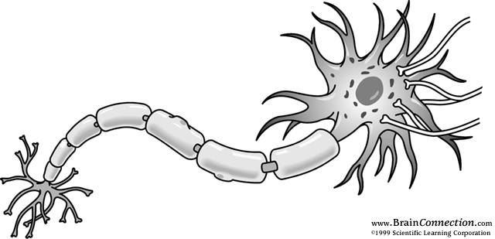
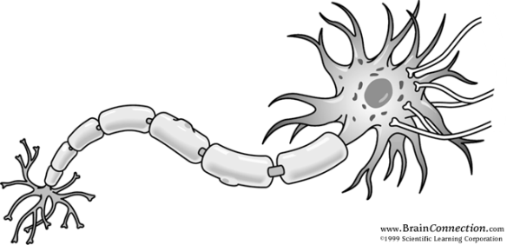
¿Cómo se desarrolla el cerebro? How Does the Brain Develop?
Notes:
Normal sensory experiences direct brain cells to their location and reinforce the connections between brain cells. We are born with more than 100 billion brain cells or neurons; we will not grow more. That's about 10 times the number of stars in the entire Milky Way, and about 20 times the number of people on the planet.
Neurons are the functioning core of the brain. Each cell body is about one-hundredth the size of the period at the end of this sentence. A neuron has branches or dendrites emerging from the cell body. These dendrites pick up chemical signals across a synapse and the impulse travels the length of the axon. Each axon branch has a sac containing neurotransmitters at its tip. The electrical impulse causes the release of the neurotransmitters, which, in turn, stimulates or inhibits neighboring dendrites, like an on-off switch.
These connections are miracles of the human body. But to understand their power, you have to multiply this miracle by trillions. A single cell can connect with as many as 15,000 other cells.
This incredibly complex network of connections that results often is referred to as the brain's "circuitry" or "wiring." Experience shapes the way circuits are made in the brain.
A remarkable increase in synapses occurs during the first year of life. The brain develops a functional architecture through the development of these synapses or connections.
For example, if a parent repeatedly calls a child a certain name, then connections will form that allow the child to recognize that name over time as referring to him and he will learn to respond. From birth, the brain rapidly is creating these connections that form our habits, thoughts, consciousness, memories and mind.
.

Slide 6
¿Cómo se desarrolla el cerebro? How Does the Brain Develop?
=
Un Nino de 3 anos ha formado un trillon de conecciones
A 3 year old child has formed 1,000 trillion connections
Notes:
By the time a child is 3 years old, a baby's brain has formed about 1,000 trillion connections — about twice as many as adults have. A baby's brain is super-dense and will stay that way throughout the first decade of life

Slide 7
Otros Beneficios Other Benefits
A los niños les encanta leer
Kids love to read
Los niños que aman los libros se convierten en buenos lectores
Kids who love books become better readers
Los niños que aman los libros eligen leer por diversión
Kids who love books choose to read for fun
Las familias disfrutan mucho pasar tiempo juntos
Families enjoy spending time together
Los niños mejoran sus habilidades de lenguaje
Kids improve language and literacy skills
Notes:
Many different parts of the brain are used in listening, speaking, reading, and writing. Parents and teachers want to stimulate all the
ways to think!
Varias partes del cerébro se usan al hablar, escuchar, leer y escribir. ¡Padres de familia y maestros necesitan estimular todas las maneras de pensar!

Slide 8
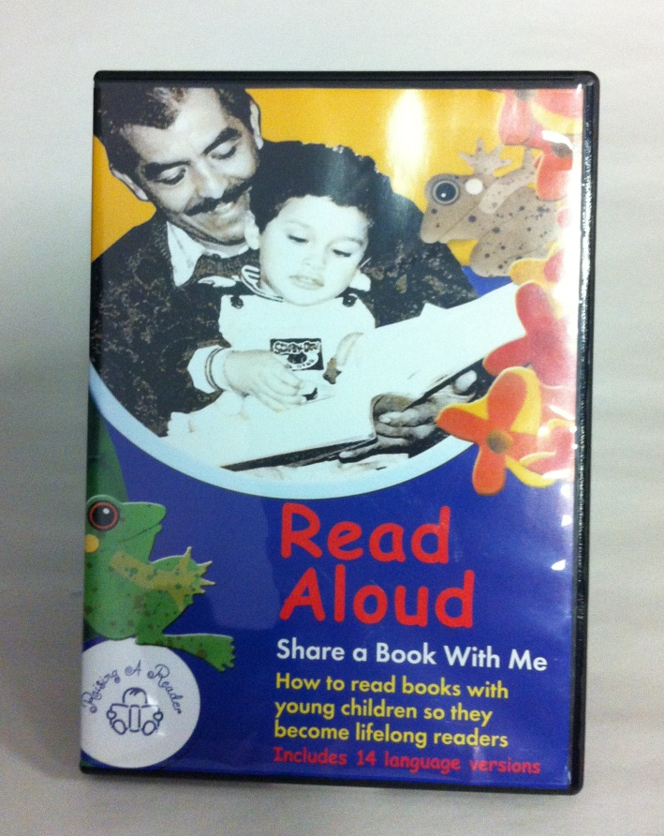
¡Vamos a ver un video! Let’s Watch a Video!
Notes:
We are now going to watch a video about reading aloud with your child. In this video, you will hear both experts and other parents talk about reading aloud and share their family experiences.

Slide 9
¿Cómo funciona el programa? How does the program work?
Notes:
Explain:
-rotation schedule
-four books gives your child choice
-go with your child’s enthusiasm

Slide 10
Cada semana su niño/a traerá una bolsa a casa
Every week your child will bring a book bag home
Cada bolsa roja esta enumerada
Each red bag is numbered
Cada bolsa contiene 3 libros
Each bag has 3 books
Las primeras 2 semanas tendrán también un DVD para ver
The first 2 weeks you will have a DVD to view
Lean juntos por los menos 20 minutos diarios
Spend at least 20 minutes a day reading a book together
Cuide los libros
Take good care of the books
Regrese los libros a tiempo
Return the books on time

Slide 13
¿Tiene Preguntas?
Do you have any questions?

