Slide 1
Raising A Reader Implementer Training
Notes:
Explain First 5 Grant award
Over the next two hours, I will be training you on how to implement and manage the program at your site. Are any of you familiar with RAR?
ICEBREAKER

Slide 2
Raising A Reader Implementer Training Goals
Increase your familiarity with the research, theory and methodology of Raising A Reader
Equip you with a clear understanding of how to implement the Raising A Reader program in your classroom
Assemble Red Book Bags
Notes:
During the first hour, I will introduce you to what the RAR is and all of the logistics of how to implement it
During the second hour, we will spend time learning how to assemble the red book bags to get you ready to begin the book rotation, and spend time planning as a site your next steps

Slide 3
Program Overview
Section 1

Slide 4
Why Raising A Reader?
3rd grade reading proficiency is one of the most significant predictors of high school graduation
  4 times less likely to graduate
  13 times less likely to graduate if live in poverty
3rd grade reading proficiency in Coachella Valley is below average
  CVUSD – 17%
  DSUSD – 45%
  PSUSD – 36%
Availability of books at home, parent engagement, and Spanish-language are key barriers
Reading problems at 3rd grade are preventable
Notes:
First I want to briefly share why United Way has chosen to implement the RAR program. RAR began with United Way’s goals to improve grade-level reading, which we know is connected to high school graduation rates and future life success among youth. Third grade reading proficiency in the Coachella Valley falls below average compared to many other communities and states; as you can see only 17% of students in Coachella Valley Unified read on grade-level by third grade. These children are at risk of not graduating high school, and the risk is even greater for children that live in poverty.
From our local needs assessment, we also discovered what some of the greatest barriers in the Coachella Valley were that impacted early literacy success, and kept students from succeeding in school. We found out that 60% of low-income families lack access to print material and books in the home, parents were not engaged or educated in child literacy, and bilingual or Spanish-speaking families were at greatest risk.
Thankfully, reading problems at 3rd grade are preventable if young children are provided with effective early literacy experiences and interventions. So United Way searched for an evidence-based program that addressed our key barriers.

Slide 5
% Scoring Efficient on CST ELA
Notes:
This chart depicts the current state of 3rd grade reading proficiency in the Coachella Valley. The orange line represents 3rd grade reading proficiency across CV, and the blue line represents the CA. It is important to note though, that reading proficiency across the three school districts is very different, with 17, 45, and 36 percent respectively for CVUSD, DSUSD, and PSUSD.

Slide 6
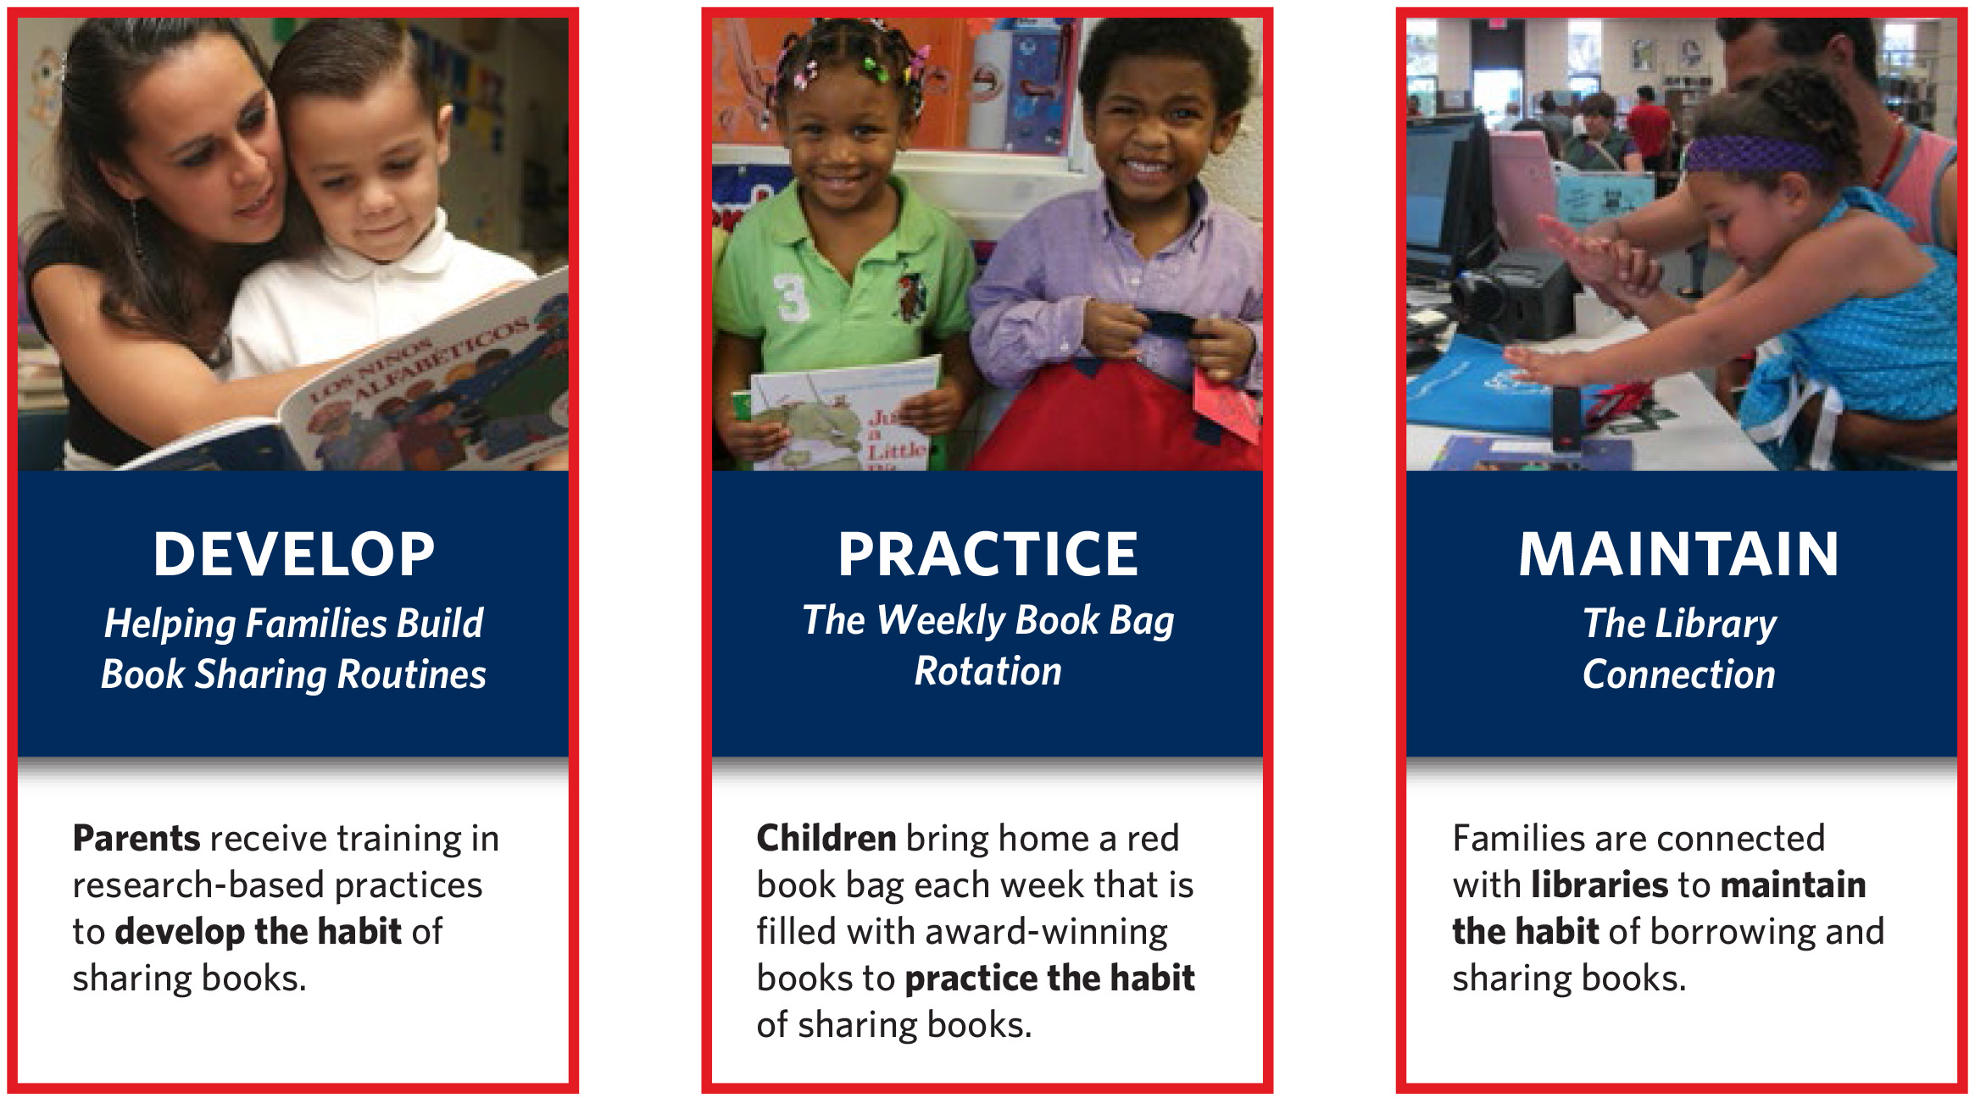
Raising A Reader
Notes:
We felt that the Raising A Reader program addressed the key barriers impacted early literacy success in our community. Raising A Reader is based on three program components, which include educating parents about the importance of child literacy and how to read with their children to develop family book sharing routines, providing a weekly rotation of books to so children have books at home and can practice the habit of sharing books and reading, and connecting families to library resources so they can maintain and continue the habit of borrowing and sharing books even after the program as ended.
These are the three components that your site will be expected to implement.
Show red book bag with books. Show Blue book bag.
We will go into more detail about each of the components shortly.
LINK TO RAR MARYLAND VIDEO

Slide 7
Raising A Reader National Video
https://www.youtube.com/watch?v=jBmEbcBhoIg&t=81s

Slide 8
Why Raising A Reader?
RAR improves family reading behavior, parent/child bonding and kindergarten readiness across diverse cultural and language demographics. Specific outcomes include improvements in:
  oral language
  pre-reading skills
  book interest and knowledge for children
  the number of books at home
  frequency of book sharing at home
  frequency of library visits following the program
  parent knowledge of the importance of literacy and family book sharing routines
Nation-wide:
  2900 implementation sites in 34 states
  Over 1.6 million children served since 1999
Notes:
The Raising A Reader program is evidence-based and has been independently evaluated to prove its effectiveness. RAR is a nationwide program, that has served over 1.6 million children in 34 states and over 2900 implementation sites. You are now an implementation site of the national RAR program.

Slide 9
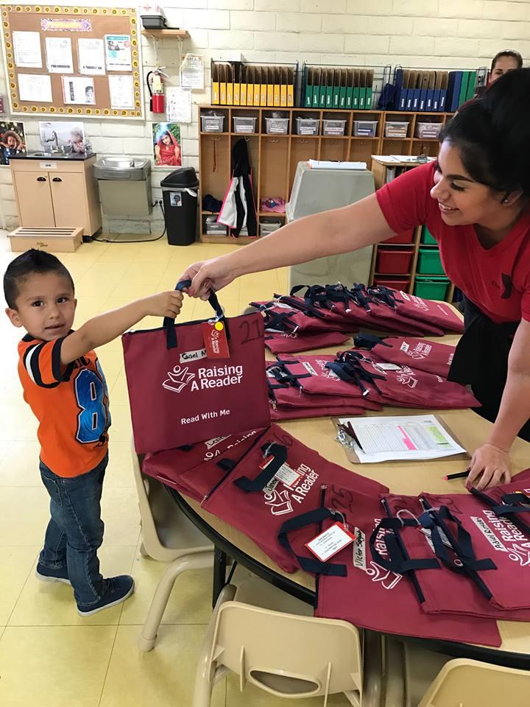
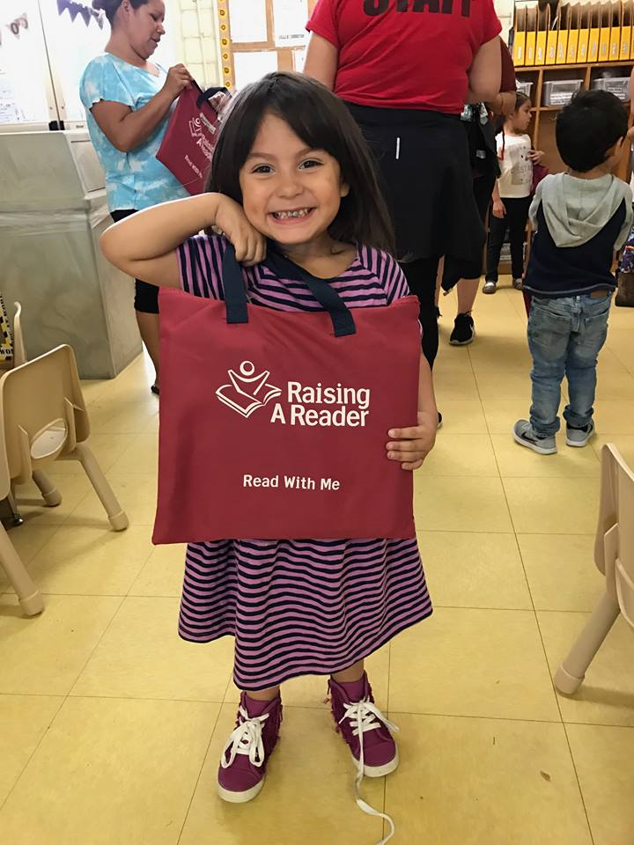
United Way of the Desert – Raising A Reader Program
Notes:
United Way has been implementing the Raising A Reader Program since 2016. Since then, the number of children we serve has increased from only 125 children and families in 2016 to nearly 2000 children and families in 2018.
SHOW UW VIDEO

Slide 10
United Way Raising A Reader Video

Slide 11
United Way of the Desert – Raising A Reader Program
Current Implementation Sites:
Martha’s Village & Kitchen Child Development Center – 24 children
YMCA Child Development Center (Indio and Palm Desert) – 190 children
Coachella Valley Unified School District Kindergarten – 1100 children
Desert Sands Unified School District ECE – 485 children
Palm Springs Unified School District Early Head Start HV – 48 children

Slide 12
Raising A Reader Outcomes & Results
INDICATORS OF SUCCESS
52%
28%
Family Reading Routines
45% PRE to 97% POST
Children’s Book Interest
27% PRE to 55% POST
“My child is so excited about reading. He loves the time we spend together and he is learning so much.” – Martha’s Village Parent

Slide 13
Raising A Reader Outcomes & Results
INDICATORS OF SUCCESS
37%
42%
Time devoted to book sharing
Family sharing books at least 60 min/week
40% PRE to 77% POST
Frequency of book sharing Family sharing books at least 3x/week
50% PRE to 92% POST
“We spend more time together and all of the other members of the family participate more. This program is great” – Martha’s Village Parent

Slide 14
Raising A Reader Outcomes & Results
INDICATORS OF SUCCESS
39%
22%
Dialogic reading behaviors
Family used 4 DRB most/all of the time
48% PRE to 87% POST
Family library Visits Family visits library at least 2x/month
13% PRE to 35% POST
“My daughter has learned new words and she now enjoys reading with her dad and I” – Martha’s Village Parent

Slide 15
Raising A Reader Outcomes & Results
OVERALL OUTCOMES
21%
71%
Barriers to book sharing
55% PRE to 34% POST
Family achievement
Improvement in least 1 indicator
“Raising A Reader allowed him to get new books each week that he probably wouldn’t have had otherwise. We learned the importance of reading and making the time to do so” – Martha’s Village Parent

Slide 16
Raising A Reader Program Aims
Healthy Brain Development
Family Engagement
Early Literacy and Language Development
Intrinsic Reading Motivation
Notes:
The goal of our program is to create a permanent change in the home environment that supports the child even after the program ends and RAR does this with four central aims in mind. You do not need to worry much about this, but this is just background information to help you understand the behaviors and outcomes the program aims to impact.
To help parents understand the importance of early brain development and provide them with activities they can do that will help their children foster healthy brain development, such as how to engage with their child while reading
Children learn through daily experiences. RAR provides repetitive experiences to promote healthy brain development and a love for reading. Do Brain Yarn Activity.
To help children develop and enhance early language and literacy skills that will be needed to succeed in school and life.
RAR encourages reading aloud which increases exposure to language and vocabulary; provides books in different genres like counting, ABCs and rhyming.
To promote and strengthen parent-child bonding and increase family engagement during the development of their children.
We know that strong parent-child relationships lead to positive child outcomes, and the more parents are engaged in learning, the better the child does academically
RAR helps children associate reading with a caring adult, and create positive relationships that last beyond the experience. RAR encourages families to read together and creates a literacy rich environment at home regardless of language spoken. As parents engage in book sharing, it promotes skills for reading readiness
To develop, foster, and promote intrinsic reading motivation.
Two components of intrinsic reading motivation, 1) a child wants to learn more about a topic, and 2) has a high level of self-efficacy associated with reading (they believe they read well)
RAR gets children excited about reading, exposes them to new ideas, and offers a choice of books

Slide 17

Program Aims:
How Can We Foster Brain Development?
How Does the Brain Know Which Connections to Keep?
Brain Yarn Activity:
Gather in a circle
While holding a ball of yarn, one person will describe what he/she likes to do with young children (e.g. sing songs).
After the first person has a turn, he/she will hold the end of the yarn and throw the ball of yarn to another person in the circle.
Repeat the process until every person in the circle has had a turn.
Notes:
The brain yarn activity is intended to help parents understand how brain connections are made and strengthened as children engage in and are exposed to different experiences. This activity is in the Implementer Manual and it is encourage to do it with parents during your Parent Education events. Do with group if there is time.
ACTIVITY**Yarn Brain
Part 1
Gather participants in a circle.
As you hold the ball of yarn explain that we are going to demonstrate a growing brain through a ball of yarn.
Start by telling participants that we are each going to describe something that we like to do with our young children (or would do if we had one). For example, play in the park, read a book, sing a song, etc. After we each describe our activity, we throw the ball to a person across the circle while holding on to the string. In this way we demonstrate how activity creates pathways in the brain, and eventually creates a web of connections.
Start the web by telling your activity, “I like to make pancakes with my child,” and throw the ball to someone across from you after calling his/her name.
After the ball has travelled to each person it comes back to you.
Explain how the string represents pathways in the brain. By doing these activities with our children, we are helping to develop their brain and building pathways.
Part 2: Repetition
Now you are going to demonstrate how repeating an activity thickens and strengthens the connections you have made.
Pick out one of the participants who is a reasonable distance away . Ask him or her what it is that she does with her child. She may say, for example, “play jump rope.” Ask her how often she plays jump rope. Did she play yesterday, is she going to play today? Demonstrate, through throwing the ball fo yarn back and forth, while holding on to the string, how repeating the activity builds the connections thicker and stronger.
Part 3: Losing Pathways
Now ask the group what they think happens when they stop doing a particular activity with their child.
Demonstrate, through your volunteer, and then with the whole group, what happens when you stop an activity. As we drop our pieces of yarn, the whole structure comes apart. This shows how brain pathways disintegrate or lose strength over time.
End the activity by saying, “But if we start doing those activities again, we build up and strengthen the pathways, we can continue to build the brain.”
Pick up the yarn again and end with a strong web!
The brain is like a muscle. You’ve got to work it out to strengthen it! You want to have a brain that is “fit”.

Slide 18
Theory of Change
Child drives the process.
Parents learn and engage in “read-aloud” strategies.
Coordinators ensure that delivery system is turnkey.
CHILD
Finance
Leads to healthy brain development, parent-child bonding and early literacy skills
PARENTS
BOOK BAG
IMPLEMENTERS
LIBRARIES
Program Implementers are trained to communicate early literacy strategies to parents.
Children and parents get to know their local library.
18
Notes:
We achieve our mission through these 5 components (anchor behaviors)
The magic begins with the child driving the process……..
Order of the Anchor Behaviors:
Child Drives the Process
Program Implementers are trained to communicate early literacy strategies to parents
Coordinators ensure that delivery system is turnkey
Parents learn to engage in “read-aloud” strategies
Children and parents get to know their local library
Raising A Reader’s Theory of Change:
If…children drive the process with the Raising A Reader red book bags and books becoming a favorite toy;
Program professionals learn how to train parents in interactive read-aloud strategies and early brain development;
Parents learn and engage in read-aloud strategies and develop a regular routine of book cuddling;
The weekly book bag delivery system is turnkey—a simple, sustainable routine that is easily managed in a number of diverse settings; and
Families start to use their local library for an additional source of high-quality reading materials…
Then…children will enter kindergarten with a love of books and ready to learn to read.

Slide 19
Program Implementation Basics
Section 2

Slide 20
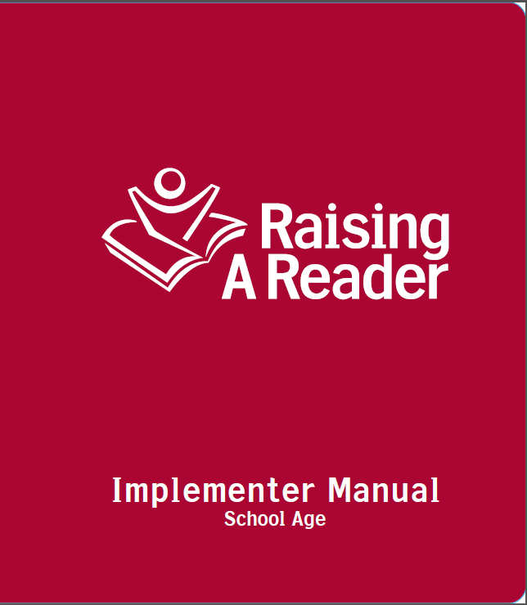
Raising A Reader Implementer Manual
Notes:
Each classroom implementing Raising a Reader will have one Implementer Manual to share. Provide group with a few to look at. I also have an electronic PDF copy of this if you would like more.
In the Implementer Manual you will find more information about research and theory behind RAR, in addition to guidelines for how to implement the program. Everything you need to know, or will be asked to do, it outlined in detail in the manual.

Slide 21
Implementation Basics
3 Required Components:
Weekly Red Book Bag Rotation
At least 2 Parent Education Events
Library Connection – Blue Library bags
Notes:
In order for the RAR program to be implemented with fidelity, and achieve the outcomes that we want, these three things must happen, and your staff will need to engage in planning to ensure they do.
Rotate red book bags weekly: Start as soon as you can after this training and all materials are assembled.
Host 2 Parent Education Events: This includes parent Kick-off, which must happen before you begin rotating books. Then, one additional event during program implementation. “Event” is flexible, and can be modified to meet your program needs or capacity. Education can occur during events parents are already attending (i.e. Xmas event, teacher conferences, etc.) Can take place in group setting or one-on-one. The goal is that parents get at least 2 incidences or exposures to education regarding child literacy
Library Connection - At the end of program, provide each child with Blue Library bag to keep and continue to practice of book borrowing, and connect them with library resources. We will discuss examples of how you can do this later

Slide 22
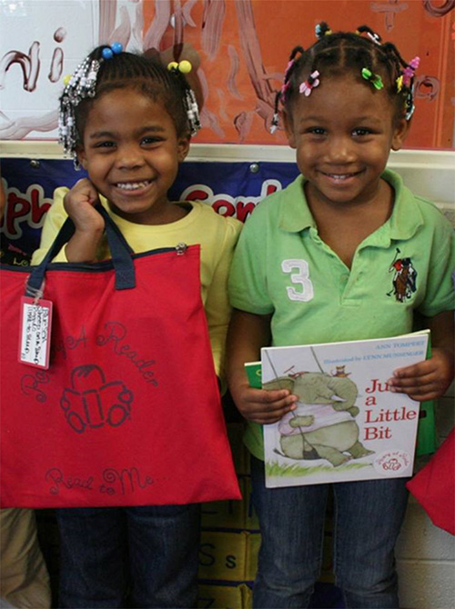
1. Book Bag Rotation
RAR Red Book Bags rotate to children’s homes every week
Pre-K Program – 4 books/bag and DVD
Only rotate books that have the Raising A Reader sticker
Notes:
Start as soon as you can after this training and all materials are assembled. l.

Slide 23
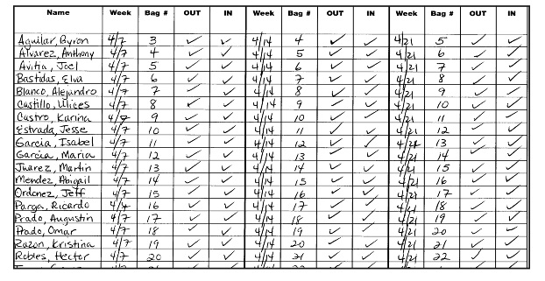
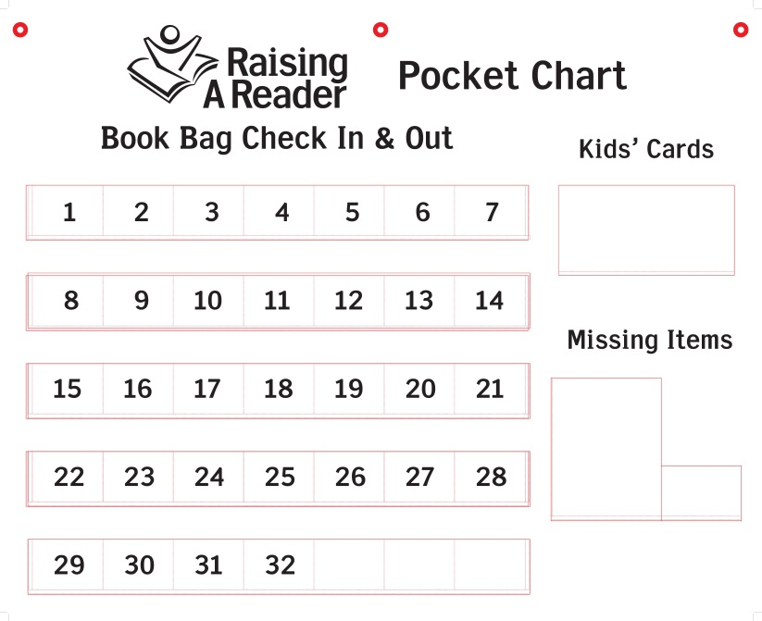
Setting Up Your Book Bag Rotation
Set up the Book Bag library
Decide on a Book Bag rotation schedule
Create a plan to track the Book Bags
  Use a tracking log
  Use the Raising A Reader Pocket Chart
Notes:
Show how you can organize the bag rotation once they are assembled. Show how to use pocket chart, including missing items slips, child card rotation, and numbers on bags
Your site will need to plan your rotation schedule, such as what days children receive and bring back the books bags. Here are some suggested tips for your chosen schedule:
Out on Thursday, back on Tuesday is most common rotation schedule. This avoids holidays on Monday and Friday, and allows teacher a day to check and rotate bags and allow an extra day for those that were not returned.
Recommend that every classroom rotate books on the same schedule so there is no confusion.
Do not suggest rotating books during long holidays from school. i.e. Winter break, Spring break, etc.
At least 2 extra bags/class
Recommend choosing one staff member to rotate the books every week.

Slide 24
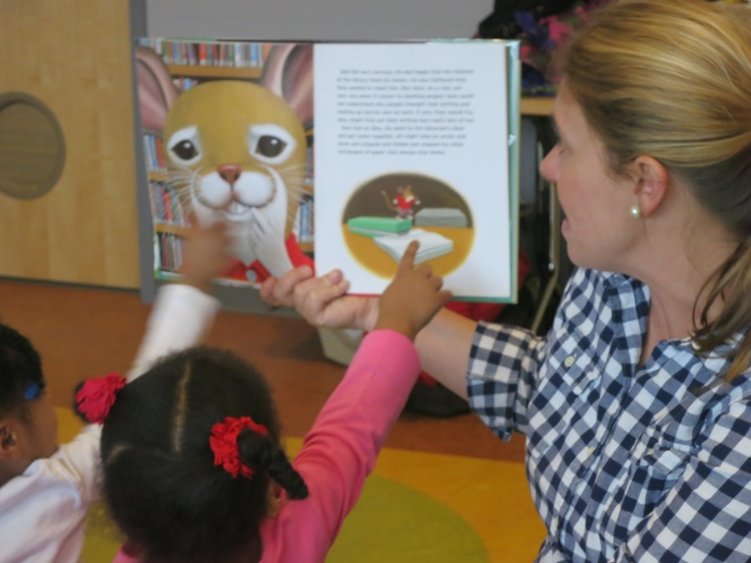
Introducing RAR to Children
Use circle time to:
Introduce the program
Sharing favorite books
Demonstrate gentle handling (Implementer Guide)
Build child’s excitement
Notes:
Once you have the book bags assembled and rotation schedule determined, plan an exciting way to introduce the program to the children. Remember, one of our Anchor Behaviors is that “The Child Drives the Process.” We want to get them excited so they go home and want to share the books with their family.
There is an entire section in the RAR Implementer Manual that gives your ideas and guidelines for how you can introduce the program to the kids.
One way to do this is for Implementers to introduce the program to children during circle time. Circle time is an ideal time for the implementers to share some of the favorite RAR books and demonstrate how to care for and use the RAR books.
A few ways to excite children:
Story bear that gets sent home with one child each week. Encourage them to read with parent and bear every day and report on their favorite book at the end of the week
Classroom job around RAR

Slide 25
2. Parent Education Events
Introducing RAR to Parents:
The Kick-Off Orientation
Purpose of the Parent Kick-Off Orientation:
Benefits of Reading Aloud
Nuts & Bolts of Raising A Reader
Strategies for How to Begin the Book Sharing Process
Notes:
One of the three required components of implementing RAR is to host at least two parent education events. The first one, is the Parent Kick-Off Orientation, and should take place before any books have gone home. The purpose of hosting a Parent Kick-Off Orientation is to help parents and families understand what RAR is all about and it sets the precedent for your entire Raising A Reader program year
During the Parent Kick-Off Orientation, Program Implementers will provide parents with information regarding:
The benefits of reading aloud;
An understanding of language • New vocabulary and concepts • A love of books and a desire to become a reader • A sense of accomplishment as their understanding and skills grow • World knowledge • Attentive behavior and listening ability
How the Raising A Reader program works and explain the book bag rotation process; Have them sign Parent Agreement and send parent letter to those that do not attend
Introduce an interactive read aloud strategy that the parents can take home to begin the book sharing process
A guide of the parent orientation and what to address is in Implementer Manual, Section III

Slide 26
Parent Kick-Off Orientation
Possible Topics to Address
Addressing Barriers:
Why aren’t all parents reading aloud with their children?
  Time
  Low English proficiency
  Low literacy skills
  Inattentive/reluctant children
  Distractions (i.e. TV)
  Intergenerational and cultural barriers
Notes:
In addition to introducing and training parents about how the Raising A Reader program works, the Parent Kick-Off Orientation also provides a good opportunity to address possible barriers that might prevent parents and families from reading aloud and sharing books with their children.
**Think-Pair-Share Activity:
Let’s take a couple of minutes and I want you to jot down some possible barriers/reasons for why parents might not be reading with their children.
(Wait a few minutes…like 2 min…)
When you are done, turn to someone next to you and share your list.
(Give pairs/groups 3 minutes to discuss and share. Invite a whole group discussion.) What are some of the barriers that people came up with?
(After groups shares out their ideas, have the predetermined ideas appear on the slide at this time.)
Pose this question to the Coordinators:
Why would this be a good topic to address during the Kick-Off Orientation?
**After the group discussion, show the video: Show the Read With Me Parent DVD
Some solutions:
-start a reading routine by sharing books for just a few minutes each day
-Take books with you. You can share books in the car, on the bus, while waiting for a sibling or at the doctor office
-When sharing books becomes routine, children know what to expect and are less resistant to give up screen time or other activities
-Choose books that the child is interested in and share the reading process (i.e. you read one page, they read one page)

Slide 27
Parent Kick-Off Orientation
Wordless Book Activity (Implementer Guide, pg. III-16)
Before you end the Parent Kick-Off Orientation, make sure that parents walk away with a SIMPLE reading strategy that they can take home and begin using with their children!
Possible Interactive Reading Strategies:
Teach parents how to do a picture walk or tell the story using just the pictures (Wordless Book Activity).
Teach parents how to ask questions.
Notes:
Before parents leave the Parent Kick-Off Orientation, they should walk away with some simple interactive reading strategies that they can begin to use right away with their children. A couple of simple reading strategies include:
▪ Teach parents how to do a picture walk.
Picture walks are great for parents who do not know how to read English words because they can still share books with their children by talking about what they see in the pictures. Picture walks are also a great strategy to use before reading any words on the page because parents can help children make predictions about what they think will happen in a story using the picture clues.
▪ Teach parents to ask questions.
Often times, parents will open up a book and then just read the words on the page without ever really discussing what is happening in the story
with their children. Book sharing is most powerful when dialogue is occurring between the parents and their children. Parents who ask their children questions about who the story is about, what is happening in the story, and what they think about the story helps build important
literacy skills such as comprehension.
During the Parent Kick-off, you can model these or other strategies to parents.
Again, a guide to the Parent Kick-Off is provided in the Implementer Manual, including more about reading strategies to share with parents.
Have them pair up or get into small groups of 3-4. Model to the Coordinators how to do a picture walk and ask each other questions about what they see in the pictures and what they think will happen in the story based on what they see.

Slide 28
Parent Kick-Off Orientation
Sample Agenda (pg. V-6 – V-7; Implementer: Section 3)
Introductions/Icebreaker
Benefits of Read Aloud
  Healthy Brain Development (Brain Yarn Activity)
  Other Benefits of Sharing Books
Opening Doors to Read Aloud
  Addressing Barriers and Offering Solutions
Show video: Read Aloud with Me DVD
RAR Program Overview and Book Rotation
Introduce Interactive Reading Strategy: Wordless Books Activity
Wrap Up
Notes:
Here is an example of a possible Agenda for a Parent Kick-Off Orientation. A more detailed agenda/outline and lesson plan can be found in Section 3 of the Implementer Guides. When planning the Parent Orientation, consider whether to include all the material described in this section, or to pick and choose elements that make sense for your audience and timeframe. This agenda is designed for 60 minutes meeting, but make it work with your needs.
For example, if you only have 20 minutes in an existing parent meeting, you can introduce the program and book rotation, and model a reading strategy to the group. The Read Aloud DVD is in every red book bag, and you can encourage parents to watch it at home.
The Read Aloud DVD is 12 minutes and covers topics like the importance of reading, overcoming barriers to reading, and reading strategies. I would encourage you all to watch it.

Slide 29
Parent Kick-Off Orientation
Parent Letter and Parent Agreement
Ask parents to sign Parent Agreement at Kick-Off
What about parents that do not attend?
  Discuss and sign at pick-up or drop-off time
  Send home
Forms can be customized to add your logo
Notes:
The parent kick-off is a good time to have parents sign the Parent Agreement
Having parents sign the agreement helps to increase their awareness about the program, and family responsibility to care for and return the books in a timely manner
Not all parents will come to a kick-off meeting, so at the least, discuss the program with them during drop-off or pick-up times, and send home the parent letter and parent agreement. This is not something that you will turn into United Way, but just something for you to ensure that parents are aware of the program before children bring books home.
I have electronic copies of this form that I can send you, and if you want you can add your agency logo. This may help parent to be more receptive to the program if they recognize your logo and partnership.

Slide 30
Parent Engagement Workshops
(Implementer Manual Section 4; Workshop Series)
After the Parent Kick-Off, Implementers must provide at least ONE MORE Parent Engagement “Event”
Parent Engagement “Events” can be used to serve two purposes:
Review and reinforce the concept of shared reading
Introduce and train parents in a new interactive reading strategy
Notes:
After the Parent Kick-Off Orientation, it is important that Program Implementers provide at least one additional Parent Engagement Workshop, for a total of two Parent Education events.
It is up to your site or classrooms to determine what to cover in this second parent engagement event. Program Implementers can plan Parent Engagement Workshops to serve two purposes:
review and reinforce the concept of shared reading discussed in parent orientation and/or
to introduce and train parents on a new interactive reading strategy to use with their children.
The Parent Engagement Workshops can also serve as a check-in for parents to share out their RAR experiences with their children and gather new ideas from fellow parents about things that are working.

Slide 31
Parent Engagement Workshops:
Reinforce Shared Reading
Purpose: Reinforce the concept of Shared Reading and its two components:
Dialogic (Interactive) Reading
Repeated Reading
Notes:
Parent Engagement Workshops that focus on reinforcing and reviewing the concept of shared reading provides Program Implementers with an opportunity to help the parents further understand what exactly shared reading is and how to successfully and effectively read aloud with their children.
At the Parent Engagement Workshops, Program Implementers will want to reinforce the concept of Shared Reading and its two components: (1) interactive reading and (2) repeated reading
This is in Section 4 of Implementer Manual
Repeated Reading
Re-reading books is important for robust brain development. Early brain development research has shown that repetition is necessary for neural networks to form. Furthermore, it is important for young children to experience stories repeatedly as the act of reading familiar stories over and over again is an essential ingredient in learning the shapes, the sounds, and the essence of language. In addition to strengthening general language skills, the primary benefit of re-reading is to build comprehension. Repeated reading is beneficial for children because it helps them master new concepts and ideas by building upon already familiar concepts as well as building the self-confidence in their
reading ability.

Slide 32
Parent Engagement Workshops
Introduce a New Interactive Reading Strategy
Purpose: Provide parents with an opportunity to further extend their knowledge about book sharing and gain new reading strategies
Parent Engagement Workshop Series:
  Asking Good Questions
  Expanding on Children’s Answers
  Recall and Prediction
  Making Connections
Notes:
Provide each classroom with hardcopy and PDF. Also available in PPT presentations
Parent Engagement Workshops that focus on introducing a new interactive reading strategy provides parents with an opportunity to further extend their knowledge about book sharing and also gain new read aloud and shared reading strategies to use with their children.
For your convenience, RAR National has developed a 4 part Parent Engagement Workshop series that provides parents with further interactive reading strategies. I have electronic copies of lesson plans in PDF or PPT available should you want it. Also the Implementer Manual briefly covers each new reading strategy and offers a same agenda and lesson plan. Remember, it is up to you to decide what to cover during this second parent education event. All of these lesson plans and strategies are just tools for you to choose from.
Asking Good Questions
A workshop that focuses on asking good questions is useful for parents who want to learn more about the kinds of questions that they can ask their children to facilitate better discussions and conversations around the books that they are sharing. Understanding what kinds of
questions to ask will help parents to better develop their children’s comprehension skills.
Expanding on Children’s Answers
Often times, when adults read with children, they typically use an Initiate-Response-Evaluate (IRE) model for asking and answering questions. Usually, an adult will initiate by asking the child a question. Then, the child will give their response. Afterwards, the adult will evaluate the response by letting the child know if they are correct or incorrect. Then, the process starts over again with a new question. As parents become more comfortable with this process and sharing and reading books with their children becomes more routine, a
workshop that focuses on expanding children’s answers will help parents think about ways that they can extend and hold deep conversations with their children about the books they are reading.
Recall and Prediction
A workshop that focuses on recall and prediction provides strategies for parents to use that will help their children work on remembering the plot and details of a story. Recall and prediction strategies are good for children to learn as they practice summarizing events in a story and learning how to reference details.
Making Connections
Making connections while reading is a very useful strategy for children to learn because it helps children better understand what is
happening in a story. When children make connections to a story that they are reading, it also helps to keep them engaged and interested. A workshop that focuses on making connections provides parents with knowledge about the kinds of connections that children can make while reading a story together.

Slide 33
Other Training Opportunities
Show the parent DVD during drop off/pick up times or while parents may be waiting for parent-teacher conferences.
Discuss the Raising A Reader program or useful reading tips with parents during other school or parent events.
“Piggy-backing” school or holiday events
Notes:
As I mentioned earlier, these family education events are flexible, as is the entire Raising A Reader program. We realize that what works or is feasible for one site, may not be for another. The point is that at some time, in some way, parents know about the program and are educated about some read aloud strategies. How this happens is up to you.
So, modify Training Requirements to fit your need and capacity - It would be ideal for all affiliates to provide a group Parent Engagement Workshop. However, this might not be a feasible option for some, or all parents might not attend events that you plan. If you find it very challenging to gather parents together for a large group training, there are other opportunities to provide families with useful information about reading together:
Show the parent DVD during drop off/pick up times or while parents may be waiting for parent-teacher conferences.
Discuss the Raising A Reader program or useful reading tips with parents during quarterly conferences or other school events.
Piggy-backing school events means holding the trainings in conjunction with back-to-school night or another event when parents are already at the school.
Example of Fashion show; holiday performance; fall festival, halloween
Does not need to be formal

Slide 34
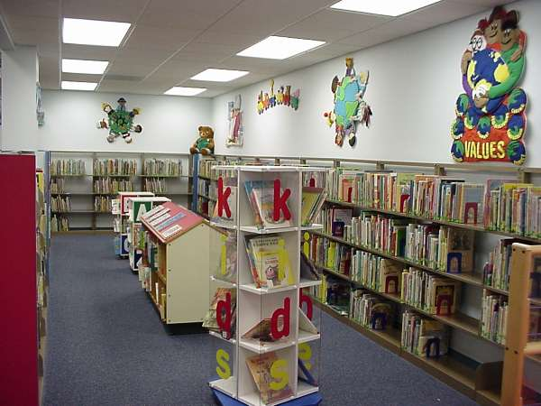
3. Library Connection
Why connect children and families to the library?
  Sustainability component
  Blue Library Bags replace Red Bags at the end of program
Notes:
The last required component of RAR is connecting families to the library
Connecting families to the libraries helps families to continue the positive book sharing habits they have developed during the program. Believe it or not, some families have never been introduced to the library and do not use it as a resource. The purpose is to really introduce or re-introduce parents to the library, how to use it, and get them and the children excited to use it as a resource.
After the RAR red book bag rotation has been established, children receive their very own blue book bag to help maintain the habit of reading aloud and visiting the library.
Each site will need to plan their Library connection event, but like other components of the program, this is flexible and is up to your site to decide what to do. The next slide will cover some possible examples

Slide 35
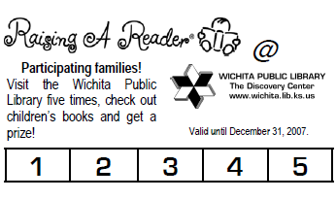
Library Connection Examples
Celebrate program completion with an event!
Field trip to library
Librarian as guest visitor
Library card applications in bags
Notes:
Some sites choose to celebrate the end of the program with a fun event for parent and kids. This is the time when they might provide children with the blue book bags and connect them with the library. Such as and end-of year event, pre-school graduation, etc.
You can plan a field trip to the library for families or just children
Invite the librarian to speak at a parent event, or to children at school
Send home information about the library, i.e. library application, brochure, event schedule etc. with the blue book bags
Best distributed 4-8 months after RAR in full swing, and accompanied by an event or ceremony

Slide 36
Program Evaluation
Section 3
Notes:
One last thing that implementation sites are responsible for is getting parents to complete an evaluation or survey after RAR has been implemented.

Slide 37
Why Conduct An Evaluation?
Understand growth
Verify effectiveness of the program
Identify areas of strengths and challenges
Discover demographic characteristics
Energize and re-motivate your staff
Produce data that can be shared
Notes:
The purpose of the evaluation is to help us know if the program is working, and if we are producing the changes in behavior and family literacy habits like we want to.
In addition to seeing the growth and positive behavior change that has taken place in the families that your RAR program serves, conducting an evaluation is useful for:
Understanding growth in book sharing and library visits
Verifying the effectiveness of the program (that you are actually doing what you think you are doing)
Demonstrating to funders that RAR is indeed helping your constituents on desired outcomes
Identifying strengths and challenges in program implementation
Discovering demographic characteristics of the families that show the most benefit from the program to inform targeted program expansion
Energizing and re-motivating your staff
Producing data that can be shared with stakeholders and funders such as school administration, district-level representatives, local PTA, etc.
Producing data that can be used for public relations and promoting services in the community. An affiliate should have a myriad of stories and hard data that tug at the “heart and the mind” of donors

Slide 38
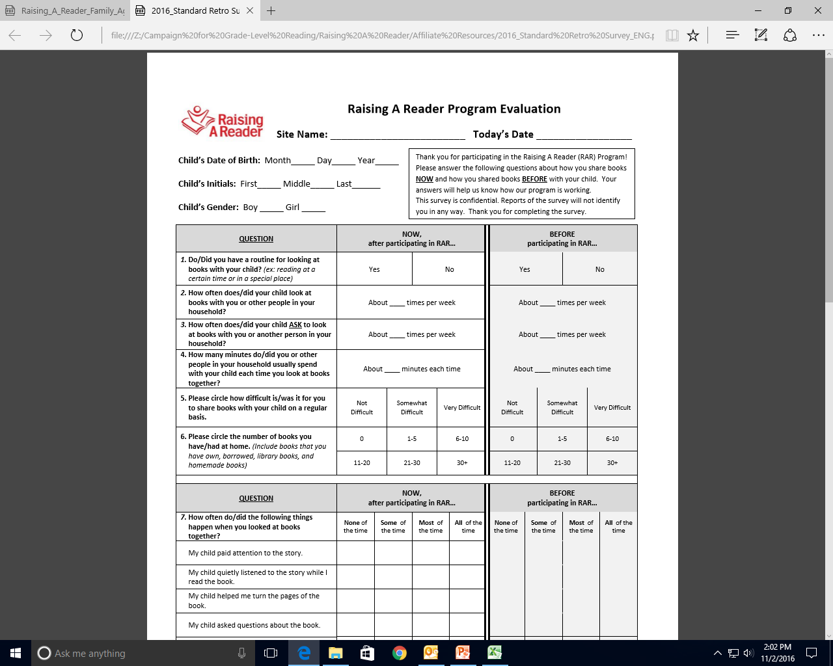
Shared Evaluation Tools
  15-item Retrospective Parent Survey
Notes:
This is what the survey looks like. It is a 15-question retrospective survey, which means it will ask parents to assess what their behaviors or habits were before and after the program, so we can make comparisons.
Please note that the survey I will provide you is different than what is in the Implementer Manual. Please be sure to use this one. I will provide to with an electronic PDF copy, and can provide hard copies if needed.
This should be completed at the end of the program, or at least 4 months after implementation begins.
Your site is only responsible for distributing and collecting completed surveys from parents, United Way will analyze the data.

Slide 39
Maximize Evaluation Response Rates (pg. VI-8)
Motivate children!
Alert parents ahead of time
Assign one staff member to distribute surveys to parents
Use mandatory parent meetings to your advantage!
Notes:
It’s not always easy to collect information from parents. Within the chosen site or classroom, the ideal is to survey all the parents and build in a process to ensure a return rate of 80-90%. Use these tips to get the highest rate of return possible:
Motivate children!
An excited child is key to collecting the pre- and post-surveys. If children are excited about it, they will excite their families.
Alert the parents to the survey process ahead of time,
and ask them to allow an extra five to seven minutes at the child pick-up or drop-off times to fill out the easy questionnaire and place it in a confidential envelope.
Ask your sites to assign one staff member to distribute surveys to parents –
personally handing the survey to each parent communicates that you value the data. With a high degree of presence at the entrance door, it is easy to catch just about everyone in a week’s time.
If you have mandatory parent meetings, set aside 10 minutes from that meeting for parents to complete the survey.
It is much easier to insure a high response rate if parents do not take the survey home.

Slide 40
Other Follow-up
Site Checklist
Material Inventory
Implementer Year-End Report
Site Visits
Classroom Reading Volunteers

Slide 41
Bag Assembly
Section 4

Slide 42
How Do I Assemble RAR Bags?
Materials will be shipped directly to site and labeled with teacher and class name
Plan 30 minutes for assembly
What materials will we receive
  Books
  Parent Education DVDs
  Red Book Bag
  Red Book Bag Tag
  Blue Book Bags
  Pocket Charts
Notes:
Link to video
Show RAR Bag and all components
Red Bag – label with number
4 books (English & Bilingual) labeled with Book Bag number
1 Parent Education DVD labeled with Book Bag number
1 Bag tag – Hooked on book bag handle and labeled with book names (optional)
Pocket Charts
Blue Bags – Keep until Library Connection Event
Materials will be shipped directly to site and labeled with teacher and class name
Plan 30 minutes for assembly

Slide 43
How Do I Assemble RAR Bags?
What goes inside each bag?
1 Red Bag/child – label with number
  4 books (English & Bilingual) labeled with Book Bag number and sticker
  1 Parent Education DVD labeled with Book Bag number
  1 Bag tag – Hooked on book bag handle and labeled with book names (optional)
  Each classroom should have 1-2 extra bags
Implementer Manual – 1 per classroom
Pocket Charts – 1 per classroom
1 Blue Bags/child – Keep until Library Connection Event
RAR Book Bag Assembly Video: https://www.youtube.com/watch?v=A4myel8-oo8
Notes:
Link to video
Show RAR Bag and all components
Red Bag – label with number
4 books (English & Bilingual) labeled with Book Bag number
1 Parent Education DVD labeled with Book Bag number
1 Bag tag – Hooked on book bag handle and labeled with book names (optional)
Pocket Charts
Blue Bags – Keep until Library Connection Event
Materials will be shipped directly to site and labeled with teacher and class name
Plan 30 minutes for assembly

Slide 44
Site Planning & Debrief
Section 6

Slide 45
Questions?
Melanie Homec
Community Impact Director
United Way of the Desert
(760) 323-2731, ext. 108
Melanie@uwdesert.org
Jacqueline McDonald
Program Coordinator
United Way of the Desert
(760) 323-2731, ext. 107
Jacqueline@uwdesert.org

